Slide 1
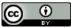
OPEN EDUCATION IN ART AND DESIGN HIGHER EDUCATION: THE POTENTIAL FOR DISRUPTION
Nancy Turner
Associate Dean Learning,
Teaching and Enhancement
University of the Arts London
@nkturner
Except where otherwise noted this content is licensed under
http://creativecommons.org/licenses/by/3.0/
Notes:
It is a real pleasure to be here today to speak to you about a topic I am very passionate about – open educational practice. I am going to talk about it in the context of activities undertaken at UAL.
How many here are very au fait with OEP?

Slide 2
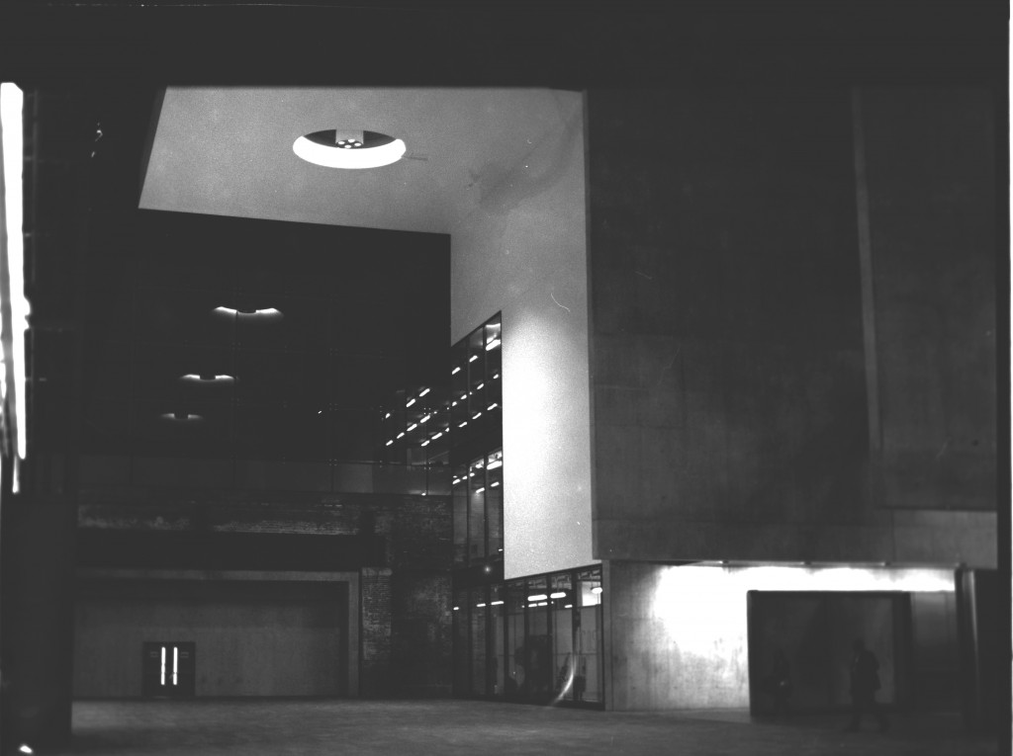
Notes:
A bit about my context – UAL is a large (by UK standards) university c. 20,000 students. The institution is specialist focused on Art Design and communications subjects. It is made up of 6 Colleges spread across many sites around London, England

Slide 3
In conclusion…
Open educational practice, as part of the change brought by rapid technological developments, challenges fundamentally the purpose and value of Higher Education (HE) and the role and identity of the teacher. The HE sector may choose to respond by transforming in the face of this change or stand by and be disrupted by it.
Notes:
By disruption I mean be forced to change or being left behind/overtaken/made obsolete
I am arguing that the changes in technology have moved us from

Slide 4
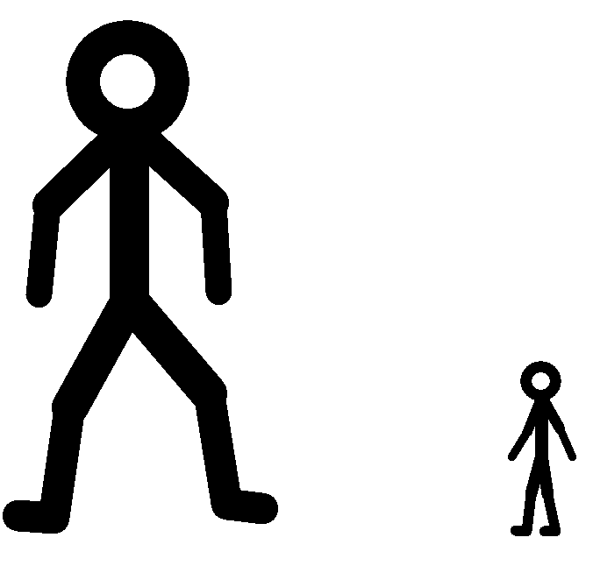
http://stickmancool.wordpress.com/
Notes:
I am arguing that the changes in technology have moved us from <<SLIDE 4>> a position of control of knowledge and one to many transmission of knowledge to

Slide 5
http://stickmancool.wordpress.com/
Notes:
one of ubiquitous knowledge and many to many networked learning
Social media and collaborative tools have moved us to many to one models

Slide 6
http://stickmancool.wordpress.com/
Notes:
where many can collaborate on production of one item.
I am going to briefly do the following:

Slide 7
What do I mean by open education
Journey of UAL
Experiences of academics
Where to next?
Notes:
I will outline what I mean by open & locate it in broader changes brought about by digital development, talk about the experiences of my institution, and academic we have spoken to about engaging in OEP and then where we are going next.

Slide 8
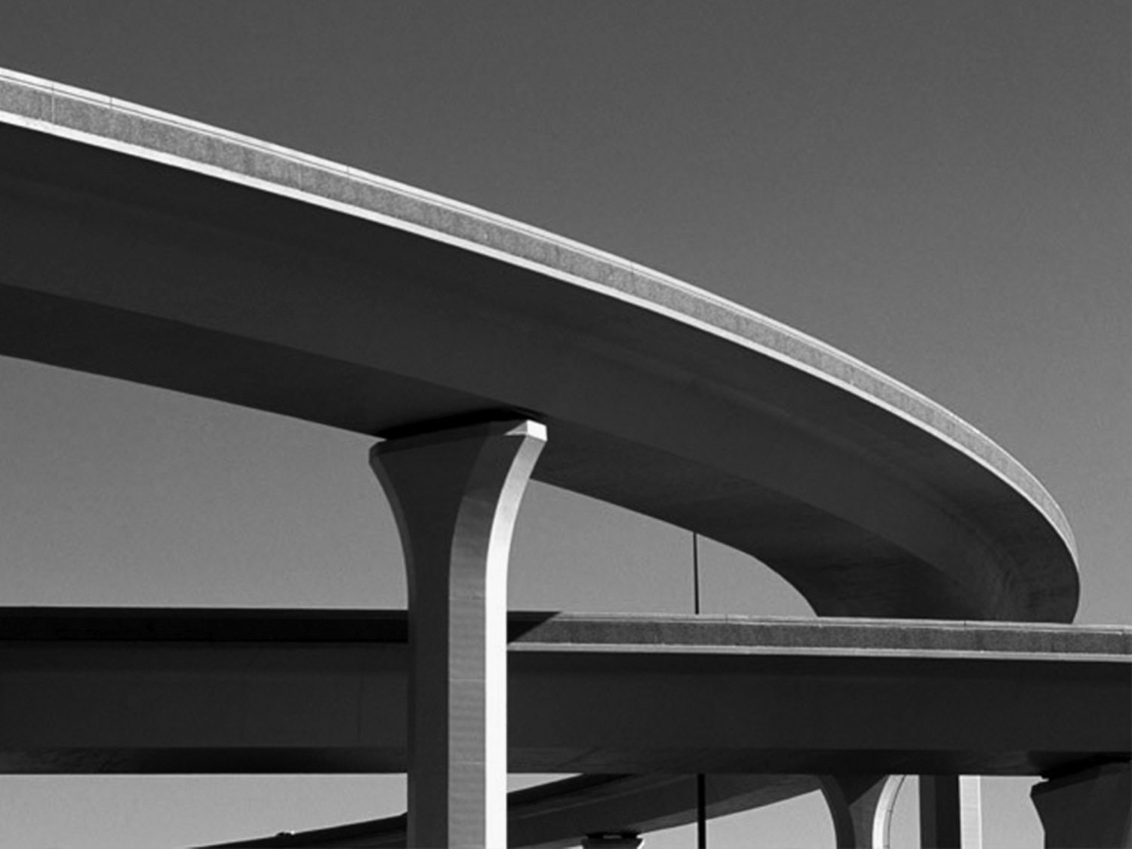
Open Educational Resources
Open Course Ware
Open data
Open access to research
Open access publishing
Open reflection on practice
Open teaching
Accreditation/badges
MOOCs
Open source software
Notes:
This is how I see the landscape of open practice in HE – It is complex and constantly changing but I have tried to capture some of the key aspects that are relevant to HE here.
includes research and teaching as well as activities such as production and use of open source software.

Slide 9
Open Educational Resources
Open Course Ware
Open data
Open access to research
Open access publishing
Open reflection on practice
Open teaching
Accreditation/badges
MOOCs
Boundary Teaching
Open source software
Notes:
I am focusing today on 2 bits of the educational side of this landscape
OER –broad category encompasses open course ware. OER are teaching, learning and research resources that reside in the public domain or have been released under licensing arrangements that permit free use and sometimes re-purposing by others.
release with clear indication of what others may use it for and how they many use it – usually done with CC licensing.
Most powerfully includes metadata so it can be found as well as info on the context in which the resource was used so the reader gets an idea of its intent and use in context.
OCW – is OER that are grouped together or created in the context of a course. This would mean that someone had access to the resources and pedagogic approaches of a course in totality. This could facilitate self study or could allow other educators to see how a subject is taught at another institution.
Open reflection on practice – where teachers post their thoughts on their teaching practice online. May be linked to an OER or may be stand alone. A public way of sharing ideas and reflections with eachother.
Open teaching – encompasses MOOCs and other forms of open teaching. A course or form of teaching is open for individuals to access and participate in. Could be time limited or not, could require signing up and include direct tuition or not.
These in combination form what I am defining as open educational practices. All together we may call these Open Academic Practices.
I am not going to cover open teaching today as that has been covered elsewhere in the conference extensively!
Powerful. I wouldn’t want to come across, however, as an evangelist. OEP doesn’t come without issues and challenges, philosophical and practical and I’ll touch on these later. Need to be clear on why we are engaging in it – what our goals are, who it is intended to benefit.

Slide 10
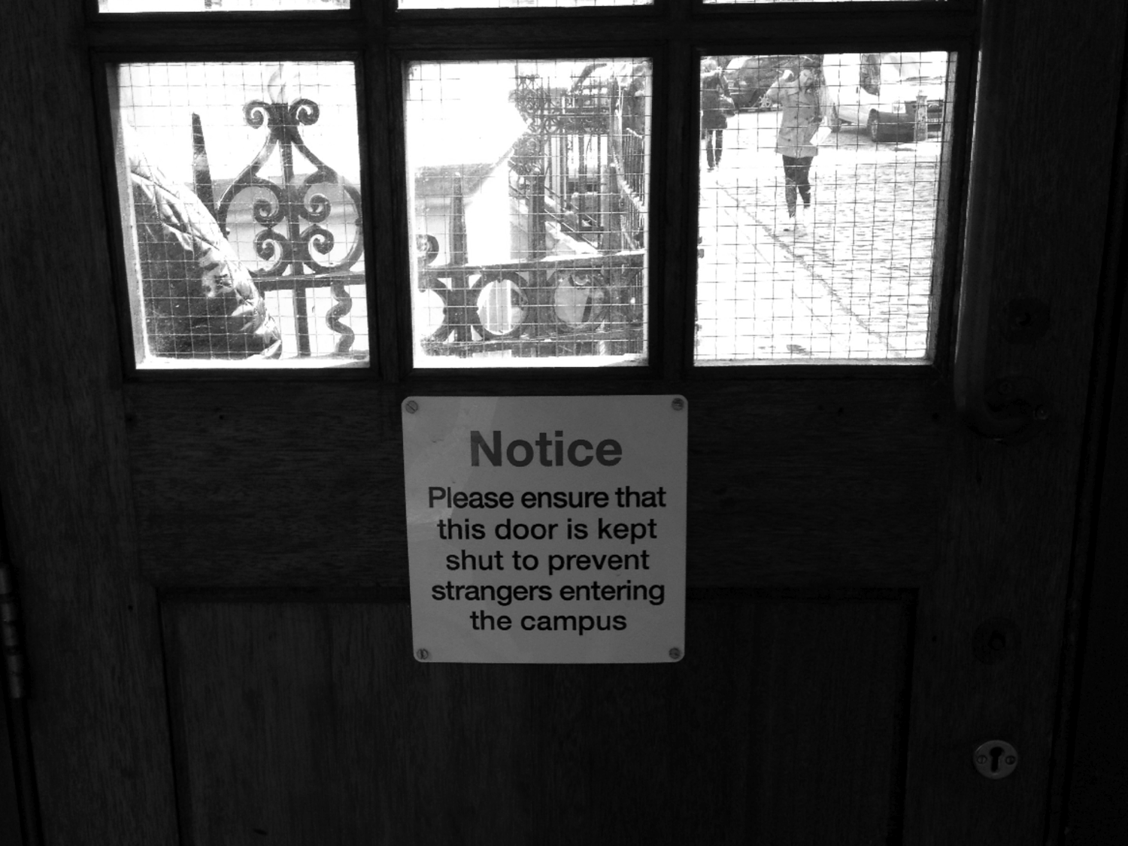
Notes:
Where have we come from? Largely closed system of education – to knowledge but also to teaching practices/approaches. Teaching has historically been a very private undertaking, unlike research, we don’t share the outputs of teaching practice in the way we do research. We don’t subject our teaching to peer review for the most part. Of course this is starting to change on both counts.
What is driving a change to this practice? I think several things are. I think increasingly students are demanding a better educational experience. Some of that is fuelled by internet access to knowledge pervasive and anytime/anywhere. Access to knowledge has been democratized in many ways – the digital age has been likened to advent of the printing press in terms of impact on society and power dynamics. Social media and collaboration is also a key component as static content is one thing but now everyone has potential of not only being a content consumer but also a content producer. Radical shift in the way we view and create knowledge. Navigating this takes new skills and new ways of knowing. The digital revolution has lead to questions on the role of the university in society – if knowledge is more ubiquitous where does this leave us. How do we equip our students to succeed in this new environment, how do we support them in developing the skills they need (oft called digital literacies) within and outside the discipline they are studying?

Slide 11
Notes:
So where is UAL sit in relation to all of this?
Until 2010 we were just dipping our toe in the water – rather random and grass roots. If people had a particular interest they did it off their own steam. We were interested in this area institutionally but didn’t have the resources to focus on it and it wasn’t yet a strategic priority on the education side (activity in relation to research, however, was occurring).
In 2010 we were lucky to get funding to undertake a project we called Arts Learning and Teaching Online. This started a cascade of other projects, some funded and some not.
A key driver for us was to use open educational practice to raise profile of UAL and A&D education, to create opportunities for staff to reflect on teaching – making implicit explicit, and to create communities where staff could share and collaborate around teaching resources improving T&L more broadly.
So what did we do?

Slide 12
Increase profile of UAL and Art and Design pedagogy in HE
Enable/support staff reflection on teaching practice (making implicit explicit)
Create communities
Notes:
I will outline what I mean by open & locate it in broader changes brought about by digital development, talk about the experiences of my institution, and academic we have spoken to about engaging in OEP and then where we are going next.

Slide 13

Produce
Use/
Collaborate
Share
\\
Notes:
At its simplest you produce and OER, you release it and then it is reused and you get feedback about it if released into a community environment.
So, what did we do in each of these 3 areas?

Slide 14
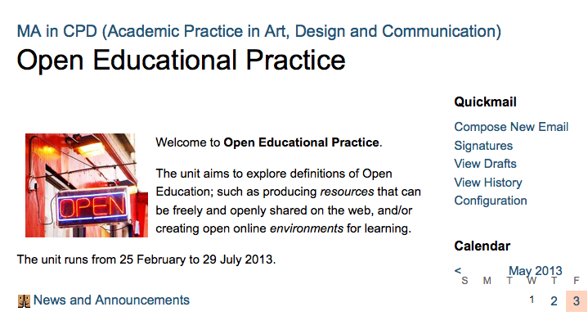
Produce
Notes:
Support – HEA funded project to develop a 20 credit unit on our MA in Academic Practice focused on OEP
Also provided 1:1 support through college based ALTO coordinators and did some general sessions to increase awareness of OER and engagement with it.
Also developed tools to support creation of OER 2 HTML 5 tools – Open course book to support creation of open course ware in a preset format. And a video tool to allow for editing of video from you tube and elsewhere into a compilation video. Both just nearing end of beta production.

Slide 15
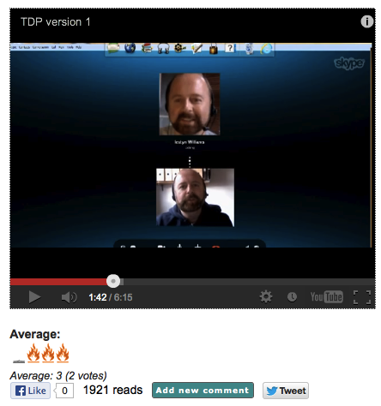
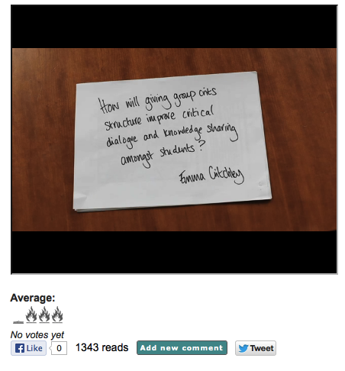
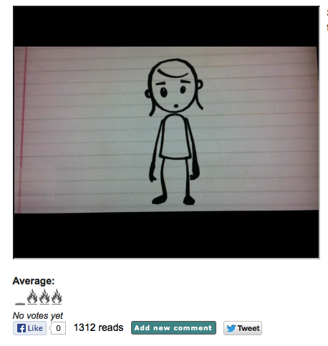
Produce
Notes:
We have also engaged in supporting open reflection on practice. We have primarily done this through out MA in Academic Practice. This is a course that our staff are required to take 3 units of (get a qualification called a Post Graduate Certificate). Activities in the class on one of the core units on this course staff complete an action research project and they are asked to record a summary of their findings and post it on PA.
There were several – all are available on our community platform PA which I will talk about in a minute – one participant did an animation and another spoke about using Skype tutorials via the medium of a recorded skype tutorial.

Slide 16
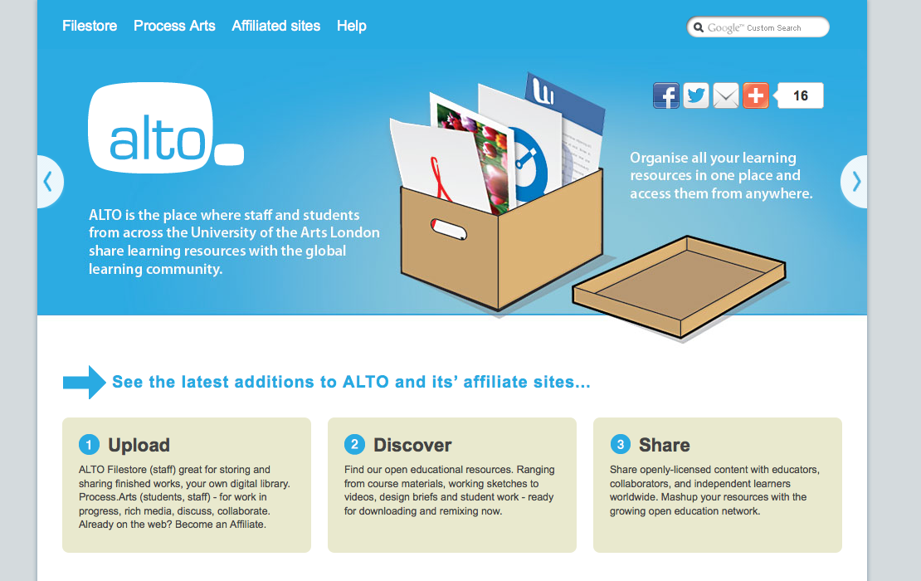
Share
Notes:
Created a platform – repository we called filestore – a place to put stuff where it can be tagged and context provided. CC licenses are used.

Slide 17
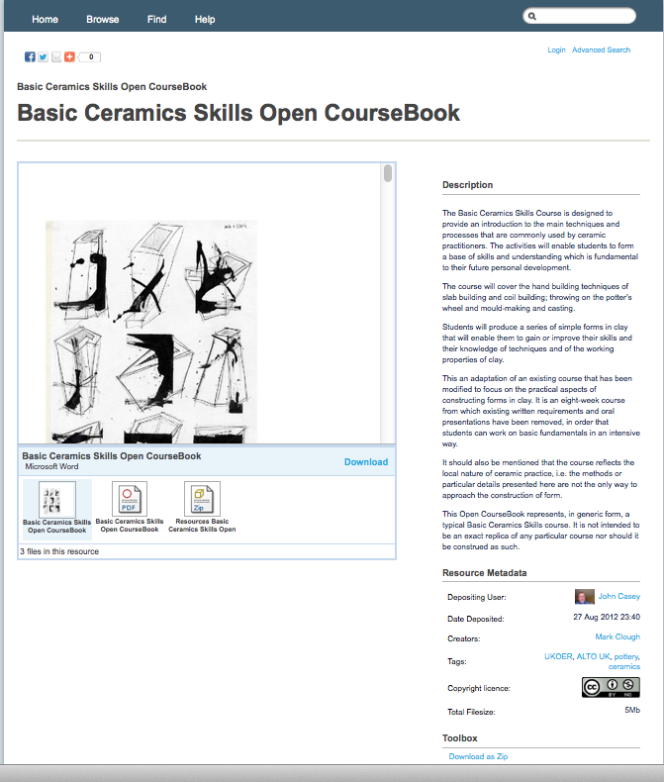
Share
Notes:
Idea underpinning this was to also have OER sharing embedded in everyday practices so we had a vision to integrate filestore with our VLE so that resources created or deposited there could automatically be placed in filestore with an individual allocating the appropriate CC license. We created a type of release we called CC UAL that would allow individuals to share just within UAL if they were not comfortable with sharing more broadly yet. We are still in very early days of ALTO – work to integrate it with other VLE tools in in progress so use and value is really yet to be seen.
Also recognized the need not only to store but to make resources visable in what we called the social layer of OER – for this we built on a tool already in development called Process Arts

Slide 18
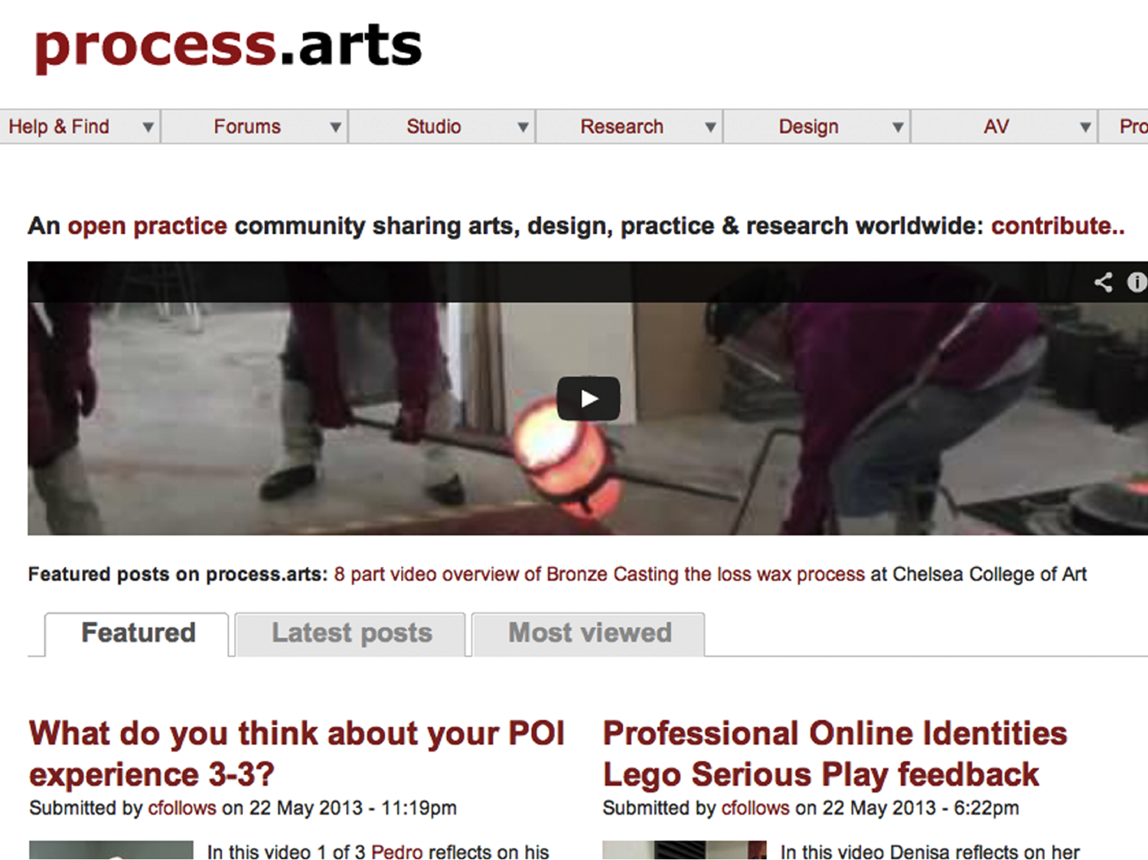
Use/
Collaborate
Notes:
People can upload their own resources, rate others, flag resources so they have their own area – comment. Primarily video content but not only video.
It is a space to share and use/collaborate

Slide 19
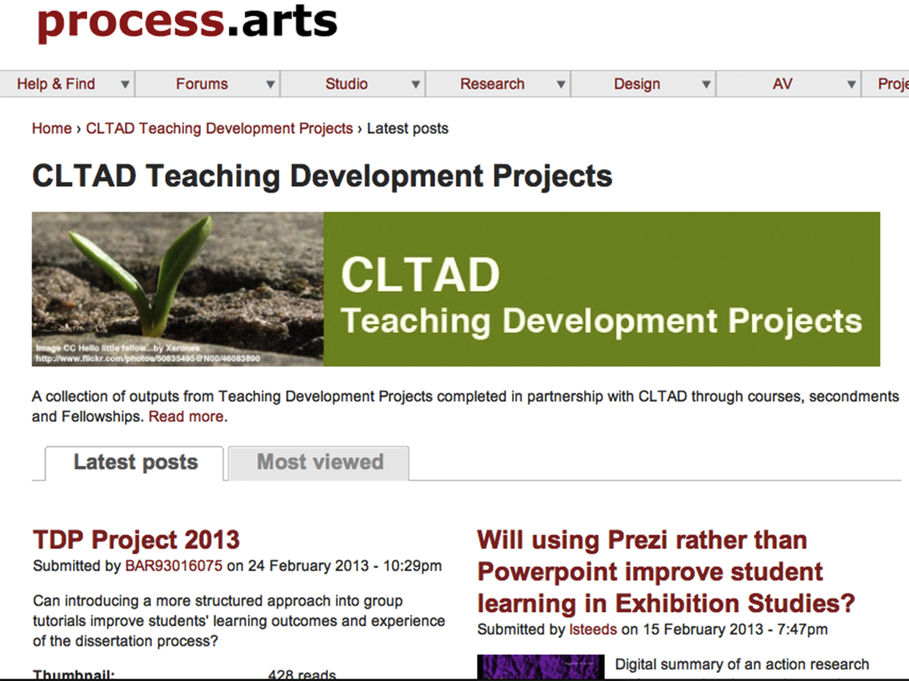
Use/
Collaborate
Share
Notes:
<<SLIDE>> - here is the page with the videos I mentioned earlier.
This social layer we felt was essential to facilitate sharing but primarily to facilitate re-use. We were aware of the low reuse of many OER that tended to be tucked away in repositories and not found by those who may find them valuable. We therefore endeavored to address this by ensuring virtual community spaces were created to facilitate discovery and re-use. PA was one, but also ISHE –

Slide 20
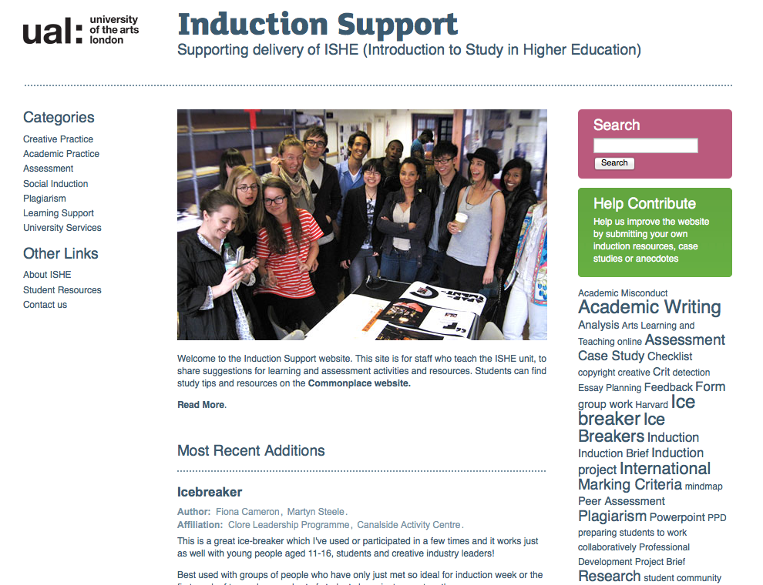
Notes:
targeted at resources to support first year students as they transition into HE. Also in the process of creating a schools and FE portal aimed at school teachers that will provide resources these teaching staff may use in supporting their students to prepare for HE study. We are doing this in collaboration with teaching staff.
We are also aware that just creating a space isn’t enough and that spaces need to be nurtured – what Wenger calls digital stewarding. We have a steward for PA and ISHE and are hoping to recruit a steward for the schools portal.
So, OER on their own are not enough, to facilitate reuse you need to think about the audience that may use them and package the resources in ways that are accessible and make sense to them. In this way the OER cycle is a very specific one that requires a consideration of audience.
So this has been our activity over the past 3 years. We have engaged staff in producing, sharing and using/collaborating around OER and OCW. We have a long way to go but are starting the journey.
We have done an evaluation of the benefits and issues that engaging in this activity creates. From a small sample of interviews and focus groups. In addition, my colleague has evaluated the insertion of open reflection into our course for new lecturers through anonymous questionnaires from her participants.

Slide 21
Conceptions of Learning & Teaching: How do we conceive of teaching and learning in our discipline/context?
Identities: How do we position ourselves in relation to teaching practice?
Digital Professionalism: How do we utilise digital tools in our teaching and disciplinary practice?
\\
Notes:
Our findings highlight three key areas that provide opportunities and challenges in engaging staff in OEP

Slide 22
Conceptions of Learning and Teaching
Identities
Digital Professionalism
\\
Notes:
We are aware these are not discrete or mutually exclusive but related and overlapping

Slide 23
“The overriding thing this has made me most aware of is how much is implicit [in assessment] that you take for granted. But only once you list and catalogue things
that you know how much you impart to students.”
Fashion Lecturer
Conceptions of Learning & Teaching
Notes:
Conceptions of learning and teaching – challenging these, particularly when ideas of teaching are about imparting knowledge. But also developing it through making what is often implicit explicit. When creating OER, and OCW particularly, you are mapping out something and reflecting on why you do it this way.

Slide 24
Conceptions of Learning & Teaching
“What might be putting off the part time lectures here is that they feel vulnerable. There is the problem of control of what the students can access. If everything is online it stops the tutor controlling what the students are being introduced to and when... they could get all their information and then avoid coming...”
Lecturer

Slide 25
“Having done this [using video recordings of textile creation processes] I am also using it in my work as a textile designer and
have used it in a collaboration in Denmark.”
Textile Lecturer
Identities
Notes:
Identities – in our context this is in relation to professional practice, but could equally be in relation to research. How do skills learned and/or ideas developed in creating OEP feed into other aspects of our professional or academic practice? Equally, if your identity as a teacher (in this case a technician) is about the trade secrets you let students in on then OER will threaten your value – related to our conceptions of learning and teaching as well.

Slide 26
Identities
“With most technicians I talk to its just completely off of their radar and they don’t understand what I am talking about.
Or if they do they are fearful of it, cause
It is that trade secret thing again.”
Technician

Slide 27
“Using video to illustrate practical
activities and using it to allow students to describe their learning processes using sketchbooks and other objects from the course. I thought that was the most
valuable and interesting part of the whole process...”
Visual Studies Lecturer
Digital Professionalism
Notes:
Digital Professionalism – skills needed to navigate professional activity but also develop these in students. Development of skills that may be important in other aspects of academic practice. But also not wanting to be shown publicly to not have these skills.

Slide 28
Digital Professionalism
“The only thing that holds me back is the technology and the quality of the output and where I am now and where I need to be in terms of my skill level to produce good quality online material – and that is all. There
is no philosophical barrier for me or for
many people I know.”
Language Centre Lecturer

Slide 29
open
Notes:
Where to next?
Development of an open UAL policy that will cut across research and teaching. At a high level it marks out our intension to invest in and support open practices. We also see this as a positive move in linking our research and teaching agendas together in a common open movement. We have a working group currently devising the draft policy with input from many groups across the institution – we will also be costing out the resources needed to sustain this work longer term.
We have seen early benefits as an institution in terms of profile and collaborations, we have also seen very tricky issues being brought to the fore and tackled as a result of this work (e.g. IPR policy). We have seen individual staff members report great things in regard to development of digital skills and shifts in their conceptions of teaching and learning. We have seen a growing infrastructure to support this work which we will continue to invest in.
We also see development of digital and learning design skills that OCW particularly facilitates as helpful precursors to development of more flexible and fully online delivered courses in our institution. This work has helped to pave the way for some of this development in the near future.
Open teaching is next on our agenda.
So, back to my conclusion…

Slide 30
In conclusion…
Open educational practice, as part of the change brought by rapid technological developments, challenges fundamentally the purpose and value of Higher Education (HE). The HE sector may choose to respond by transforming in the face of this change or stand by and be disrupted by it.
Notes:
This contention could be interpreted as scare mongering and that is not my intention. Duke (2004), noted that HE institutions can get caught in oscillation between desperate hope and desperate fear – with neither leading to evidence based rational decision making. We need to navigate through this rapid change in a considered and informed way.
Engaging in OEP whilst considering the issues and challenges can bring many benefits

Slide 31
“It’s about justifying to students when you show them the resources that’s a powerful way of showing how good we are... Prowess and confidence that we’re comfortable showing what we can do.”
Lecturer
Notes:
<<SLIDE>> We can show the power of A&D teaching and raise the profile of the disciplines

Slide 32
“It prompted me to think differently, to step back and reconsider a lot of things.”
Visual Studies Lecturer
Notes:
<<SLIDE>> We can facilitate reflection and improvement in practice

Slide 33
“[I have a] sense of belonging to a larger community... wider views than my own situation.
I feel enlarged by the experience...”
Ceramics Lecturer
Notes:
<<SLIDE>> We can build virtual communities, steward them, and gain the benefits of many to one to improve teaching practice
OEP can be a very disruptive force but can provide us with the opportunity to do all of these things is we respond to it whilst asking
-what is our intention in engaging in OEP
-whom does it benefit
-what are the caveats and challenges it presents that need to be considered

Slide 34

ACKNOWELEDGEMENTS
John Casey
Siobhan Clay
Chris Follows
Lindsay Jordan
Notes:
Acknowledgements
Colleague - Lindsay, Chris, John Casey, Siobhan
Supporters:
UAL logo
Funders:
JISC logo
HEA logo

